Slide 1
New Restaurant Suburb Recommendations
May 2020

Slide 2
New Restaurant location recommendations is a tool for stakeholders
The General success of a Restaurant takes many factors, therefore additional insights into any of these factors can assist in its success.
This information will better inform entrepreneurs, restaurateur or franchisers whom wish to make informed decisions on the type and place of a new restaurant.

Slide 3
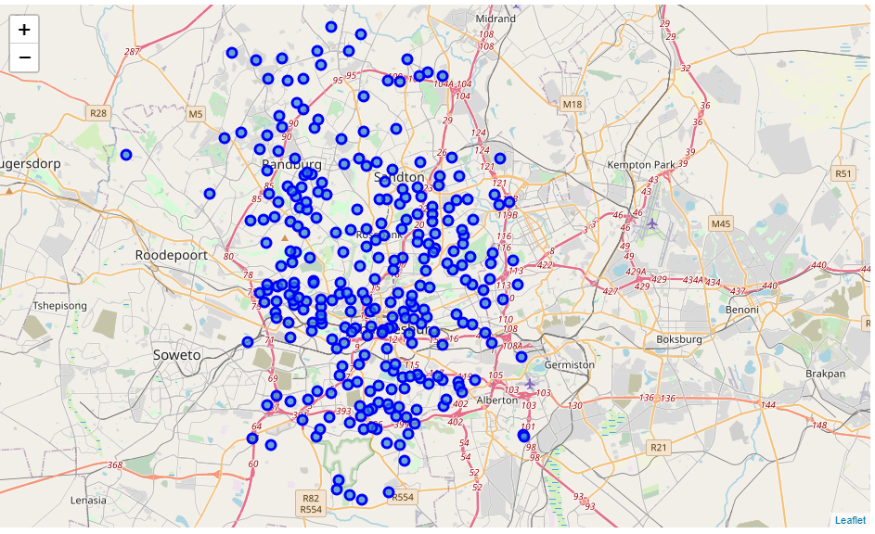
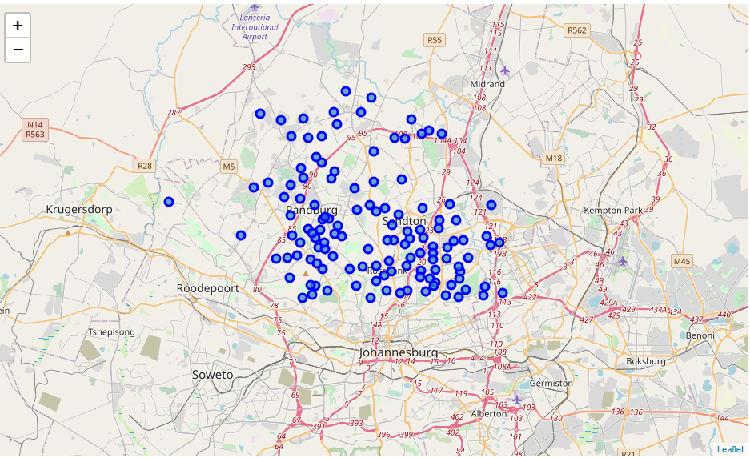
Data Collection and Cleaning
Information came from multiple sources each enriching the previous data set
The initial suburb list was provided by http://geo.mycyberict.com/ for Johannesburg, South Africa and contained 1560 Suburbs, after filtering and exclusions 127 of the northern suburbs were used in the analysis.
Pre-Filtering and Exclusions
Post-Filtering and Exclusions

Slide 4
Data Collection and Cleaning - Continued
Use of geopy enriched these suburbs with co-ordinates, Foursquare was then used to enrich each suburb with a list nearby venues within 2km
Of the 6298 Venues, 739 could be identified as restaurants
The final data set contained 739 Rows and 7 features

Slide 5
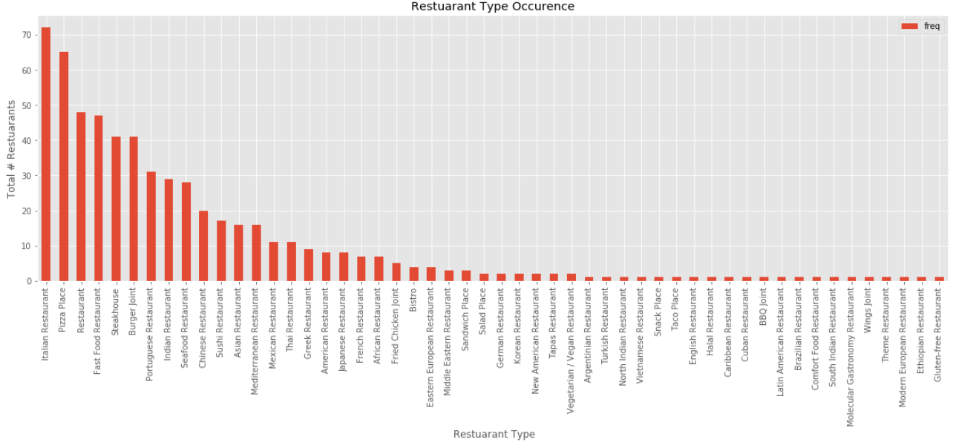
Exploratory Analysis Type & Frequency
To start the analysis portion it was though best to identify the best type of restaurant to open based on how many competitors were in the market and how well rated the type was.
It was found that the most frequently found restaurant in the northern suburbs were:
Italian
Pizza Places
Generic/Family

Slide 6
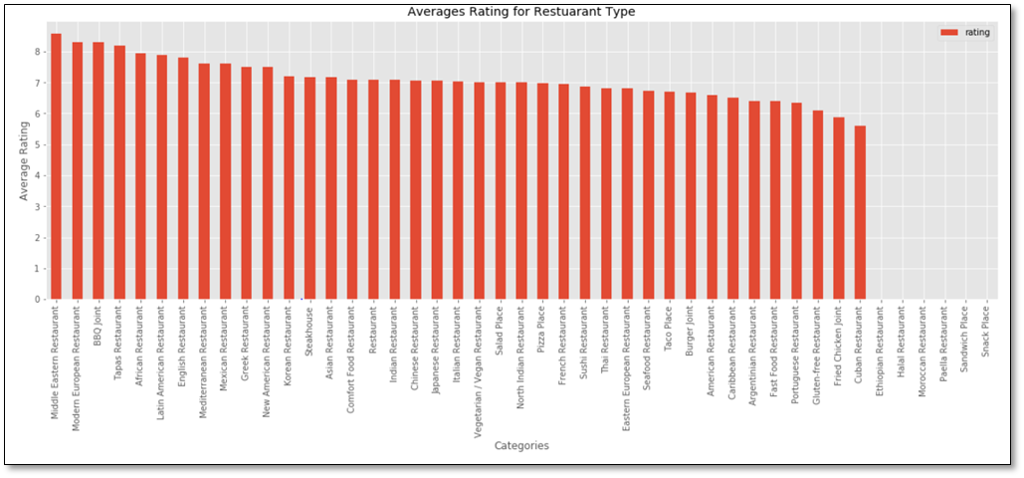
Exploratory Analysis Type & Frequency
It was deemed best to also review the average rating of these types to ensure that the quantity of a type did also not mean it was of a lesser standard
It was found that there was a general high rating to the restaurants ranking in the top 3 were;
Middle Eastern
Modern European
BBQ Joint

Slide 7
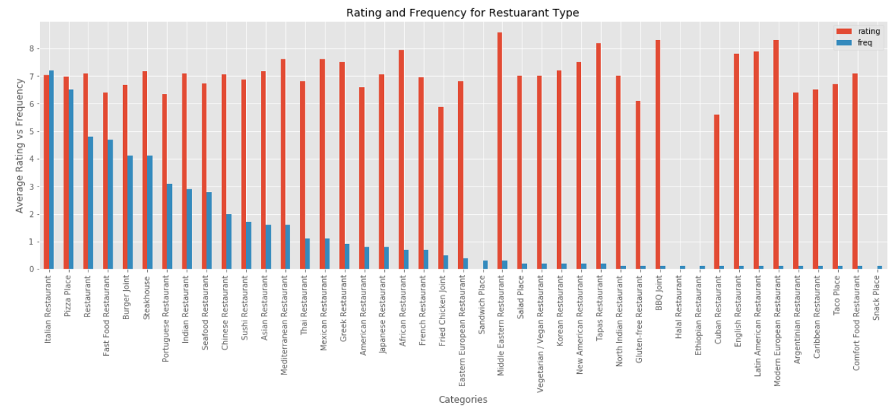
Exploratory Analysis Type & Frequency
The disparity between frequency and rating lead to the below graph, showing that restaurants had low frequency and high rating. These were deemed as unreliable as the data set was too small on these types to confirm their ratings are valid and that the type would be a viable option as it may serve a niche segment.
It was decided that the combination of frequency and rating made the top 3 most commonly found restaurants to be the viable options

Slide 8
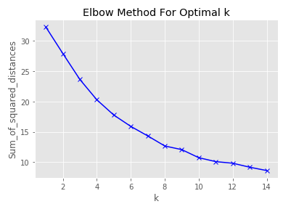
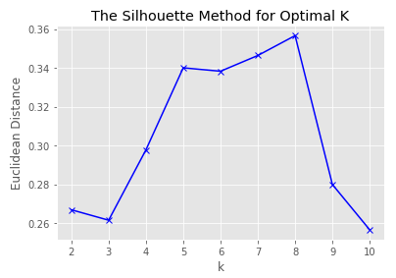
Analysis K-means Clustering
Clustering process hit an early issue with the identification of the correct K value to use.
The Elbow method showed no distinct ‘elbow’.
The silhouette method resolved the issue indicated by its peak at K = 8

Slide 9
Clusters:
8 clusters were generated each with distinct makeup:
Cluster 1: Mixed cluster - This cluster seemed to be an outlier with no matching suburbs
Cluster 2: Portuguese and Chicken - This Cluster can be classified as having a heavy presence of Portuguese and Fried chicken Restaurants.
Cluster 3: High Density Entertainment Zone - This has grouped the high density entertainment suburbs, we can see that the top rated and most frequently found restaurants in our analysis are all present as top 5’s in the below areas, most instances contain multiple instances of the high rated restaurants,
Cluster 4: Generic & Vegan/Vegetarian Restaurants - This cluster has a high focus on generic family restaurants and vegetarian places,

Slide 10
Clusters:
Cluster 5: Italian, Pizza Places & Indian - This cluster has a strong presence of the Italian and Pizza Places with a small secondary weighting of Indian food, closer analysis showed that in most cases the frequency of restaurants found to be 4th or 5th most common in the suburb did not appear more than twice.
Cluster 6: Pizza and vegan/vegetarian - This cluster surprisingly follows a very distinct pattern of occurrences of restaurants despite being separated by a fair distance.
Cluster 7: Italian and Asian foods - This cluster includes 1 outlier that does not seem to match the general format for the other suburbs, but in either case a strong Italian, Japanese and Indian restaurant presence can be found in these suburbs
Cluster 8: Steakhouse - This Cluster has a strong presence of steakhouses.

Slide 11
Recommendations
3 cluster recommendation were made for each of the top 3 restraint types, based the lack of that type appearing in the cluster.
The next few slides will show 2 of the 3 cluster recommendations to emphasis the reasoning behind the recommendation

Slide 12
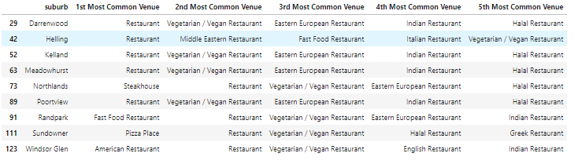
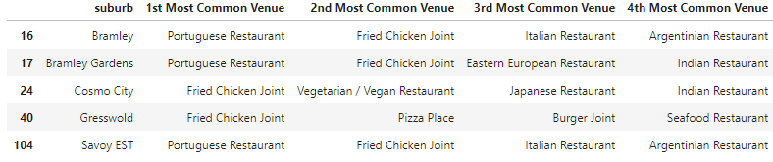
Recommendation – Italian Restaurant
Recommend 1 - Cluster 4: Generic & Vegan/Vegetarian Restaurants
Recommend 2 - Cluster 2: Portuguese and Chicken

Slide 13
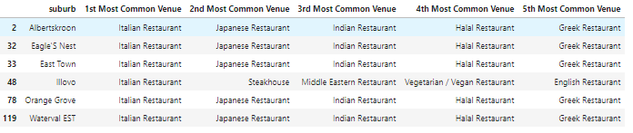
Recommendation – Pizza Place
Recommend 1 - Cluster 7: Italian and Asian foods
Recommend 2 - Cluster 4: Generic & Vegan/Vegetarian Restaurants

Slide 14
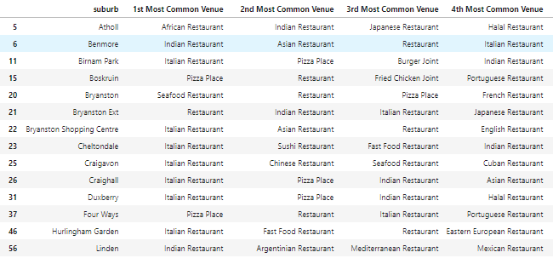
Recommendation – General/Family Restaurant
Recommend 1 - Cluster 5: Italian, Pizza Places & Indian
Recommend 2 - Cluster 7: Italian and Asian foods

Slide 15
Conclusion & Final Thoughts
The methodology has merit, but requires more in depth details or features of both the Restaurant type and the suburb.
Inclusion of a restaurant grading (takeaway, low-end, Fine dining) would go a long way to better understand the available restaurants
Inclusion of the demographic or commercial/residential components of a suburb also would have helped as some areas I found were still more industrious than residential/commercial making them unviable suburbs before analysis even.
Use of geocoding instead of a radius measure of nearby venues may have provided greater depth to the data, as issues with radius overlap and underlap of suburb became apparent

